Slide 1
Nature-based solutions in the Green Halo John Durnell - Hampshire & Isle of Wight Wildlife Trust 9th June 2021

Slide 2
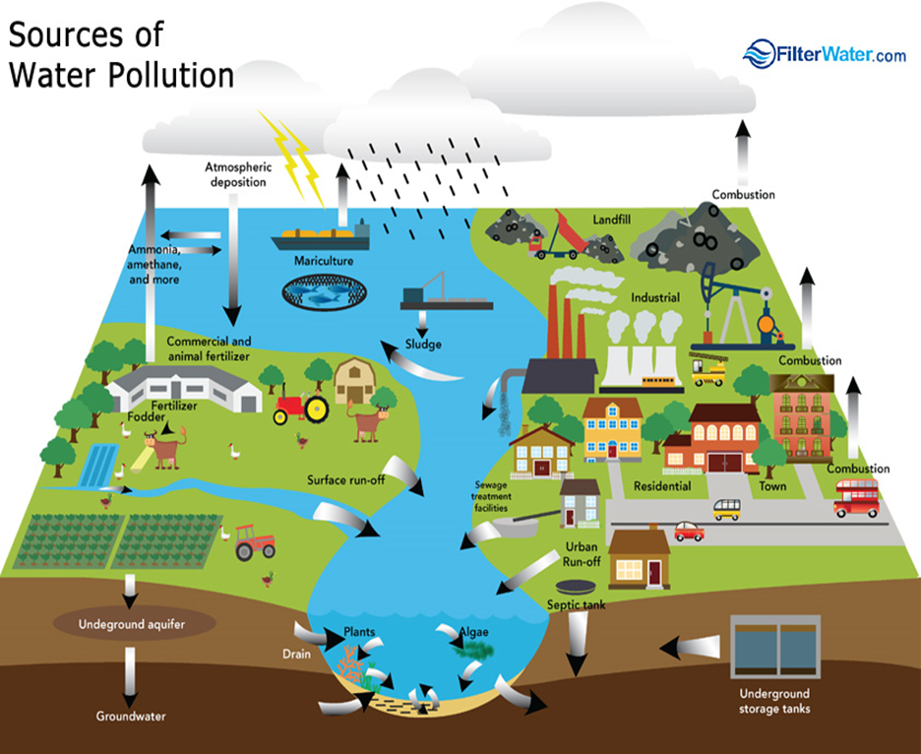
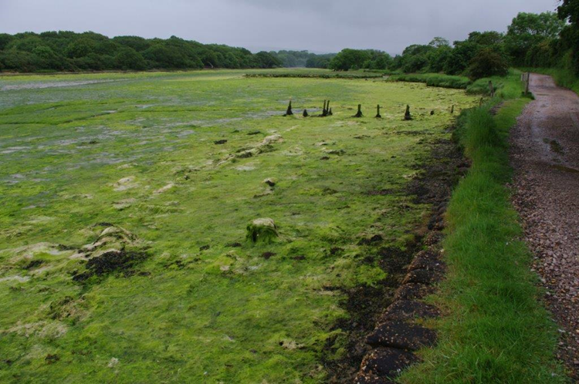
The problem of Solent nitrates
Levels of nitrogen in the Solent have reached crisis point.
Predominant source of nitrogen is from agriculture.
Other sources include wastewater from residential homes.
A large amount of nitrogen is ever-present in the Solent’s water – often described as coastal background.
This has built up from various sources over decades including: fertilisers seeping into groundwater, runoff, atmospheric deposition, storm discharges, sewer misconnections.
Whatever the source, nitrogen pollution is now a serious issue.

Slide 3
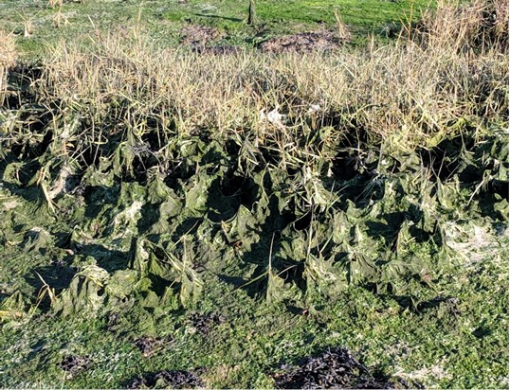
Impacts of pollution
Nitrogen pollution causes an excess of nutrients in the ecosystem.
Nutrient overload creates vast mats of algae over the Solent’s mudflats, stopping oxygen reaching the animals in the sediment and causing mass mortality, especially in hot weather.
Algae also forms a barrier to many birds which rely on probing the mud or picking off tiny invertebrates from its surface.
These mats can smother some of our most special and threatened habitats: seagrass beds and saltmarshes, choking them to death and risking erosion.
The Solent’s designated sites are in unfavourable condition due to this problem.

Slide 4
In summary our nitrates ‘rewilding’ scheme will
Demonstrate nature-based solutions and influence sustainable development
Deliver significant wildlife benefits in perpetuity
Deliver nitrate reductions i.e. more than neutrality

Slide 5
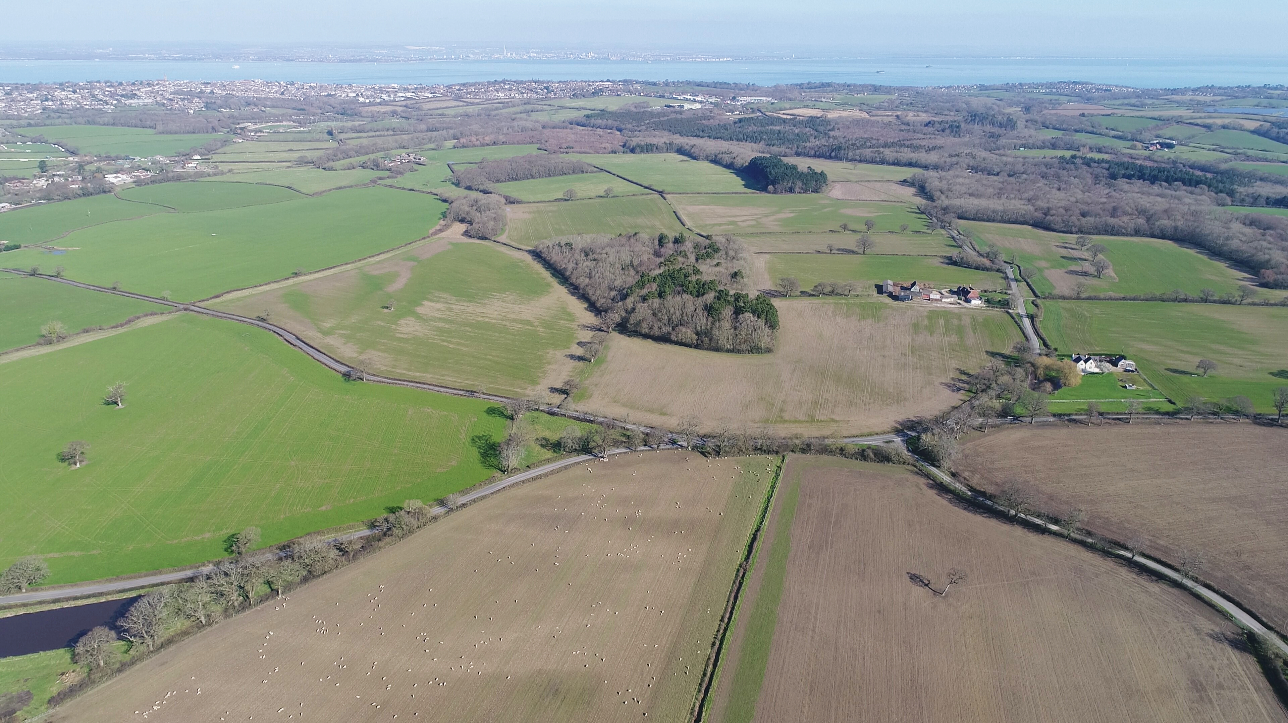
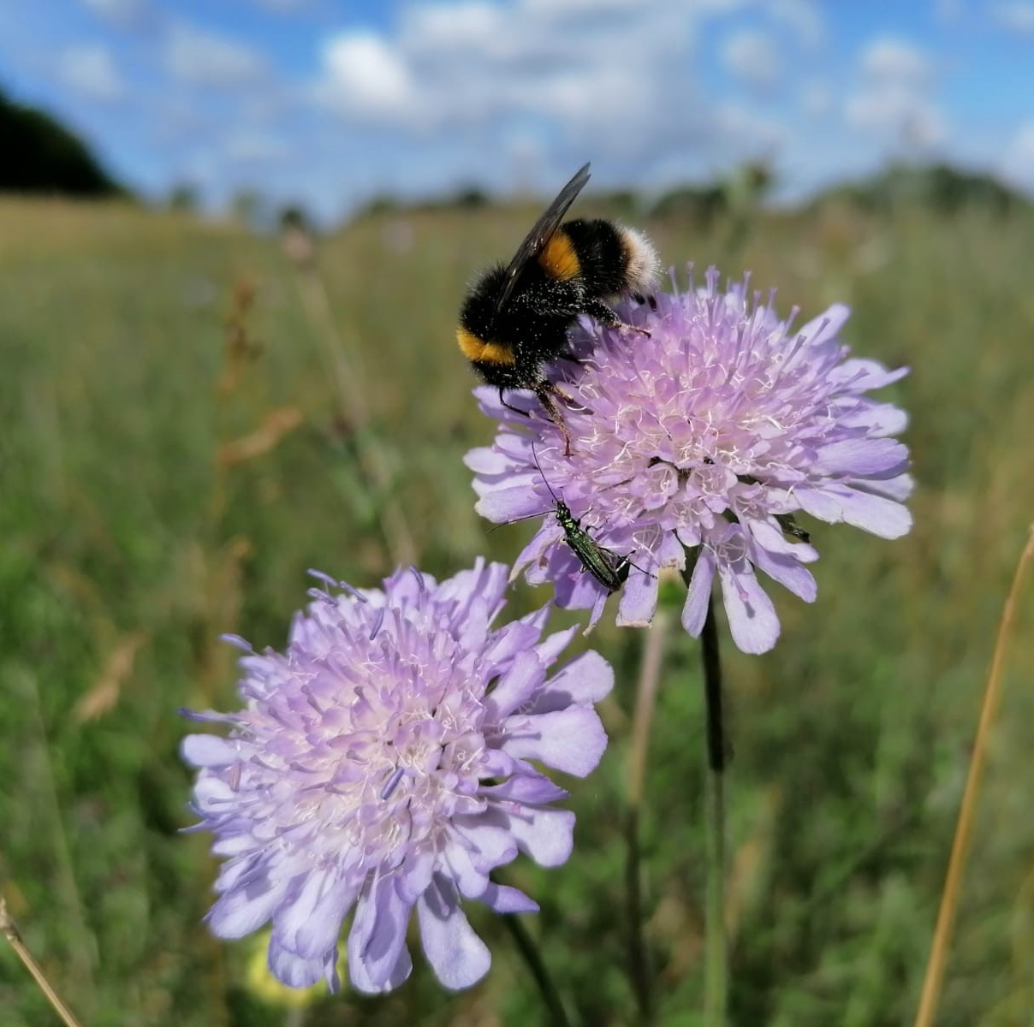
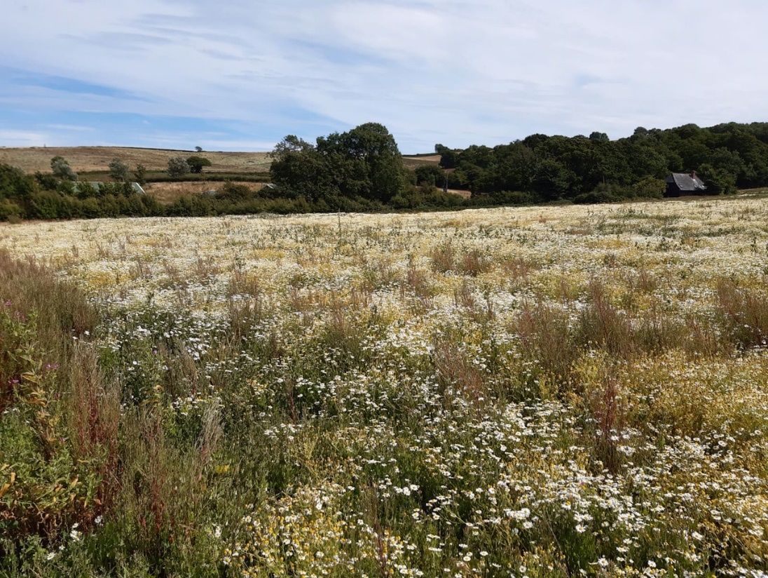
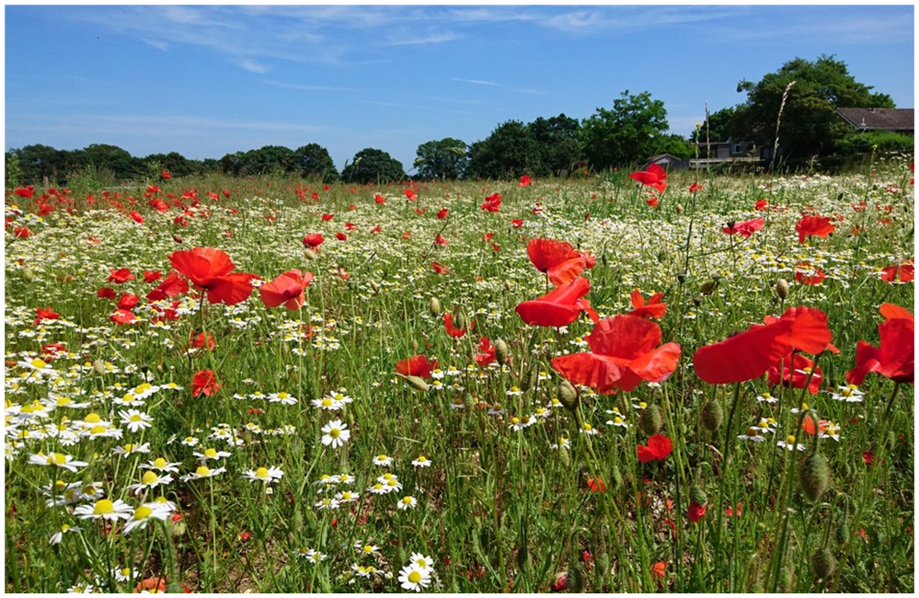
© Steve Waterhouse
© Mike Snelle
Little Duxmore Farm
© Chuck Eccleston
Nunwell Estate

Slide 6
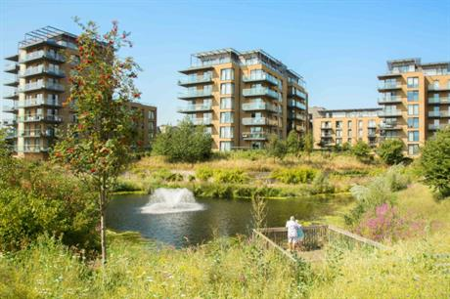

Slide 7
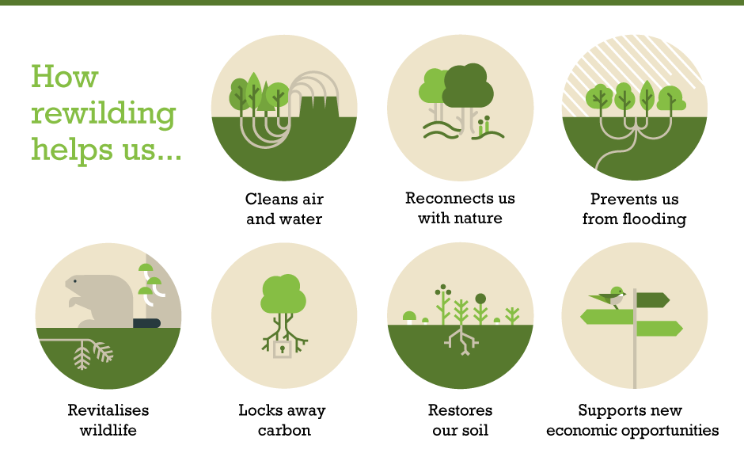
Wider benefits of ‘rewilding’ nature-based solutions

Slide 8
Contact us: john.durnell@hiwwt.org.uk

