Slide 1
Green Halo – Towards 2030

Slide 2
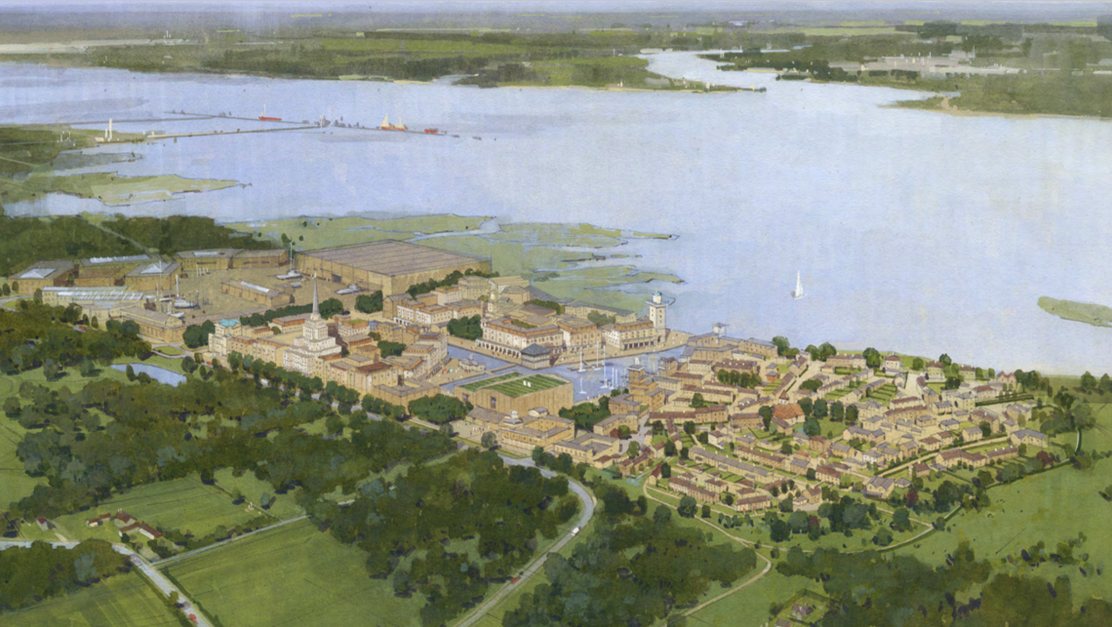

Slide 3
Masterplan
Create a beautiful mixed-use town with strong economic potential.
Comprehensively redevelop the former Power Station site & its surrounding land, providing 1,500 homes, 2m sq. ft. of commercial, civic & employment space & signiﬁcant landscape and habitat enhancements.
The scheme will remove the large, domineering buildings of the power station & replace them with a high quality built & natural environment.
Guiding Principles
Building a sustainable community in the New Forest
Extending the Forest to the Sea
Providing a genuinely mixed-use community including homes, jobs and services, in which residents can access daily needs within just a short walk.
Promoting sustainable transport by reducing the need to travel, providing transport choices & creating streets for people.
Delivering a rich and varied urban experience centered around the enlarged dock & canal.
Creating a hub for tech-based companies, including smart city & marine technology.
Committing to long-term stewardship & management.
Comprehensively regenerating the former power station site with major enhancements to landscape & biodiversity.
Improving public access with a network of footpaths and grazing routes, connecting the forest to the coast.
Restoring and enhancing the natural environment to create a Nature Park that increases biodiversity, landscape quality &recreational access to the countryside.
Creating new landscaped spaces including parks that support health & wellbeing.

Slide 4
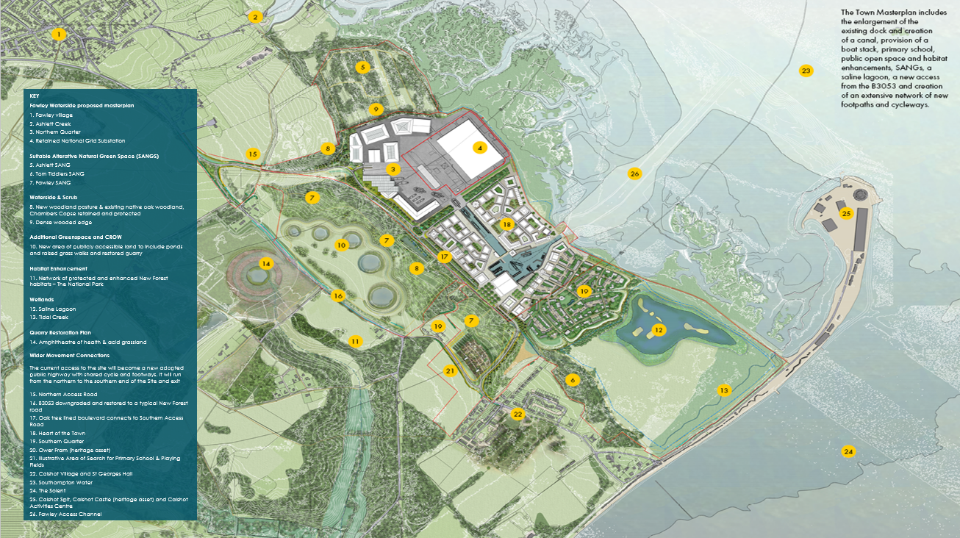

Slide 5
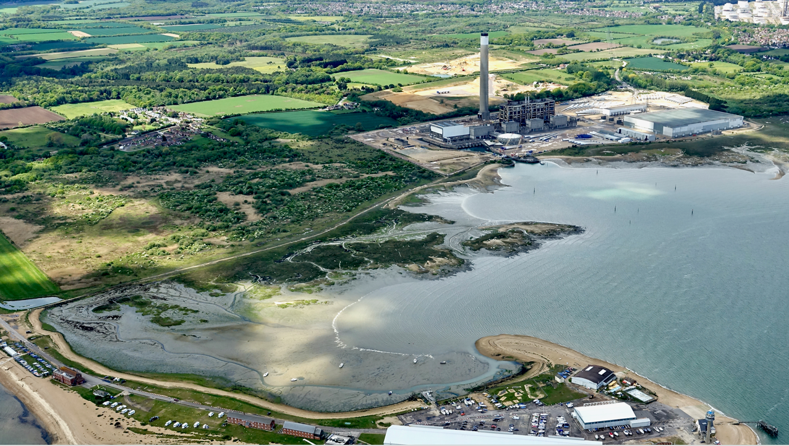

Slide 6
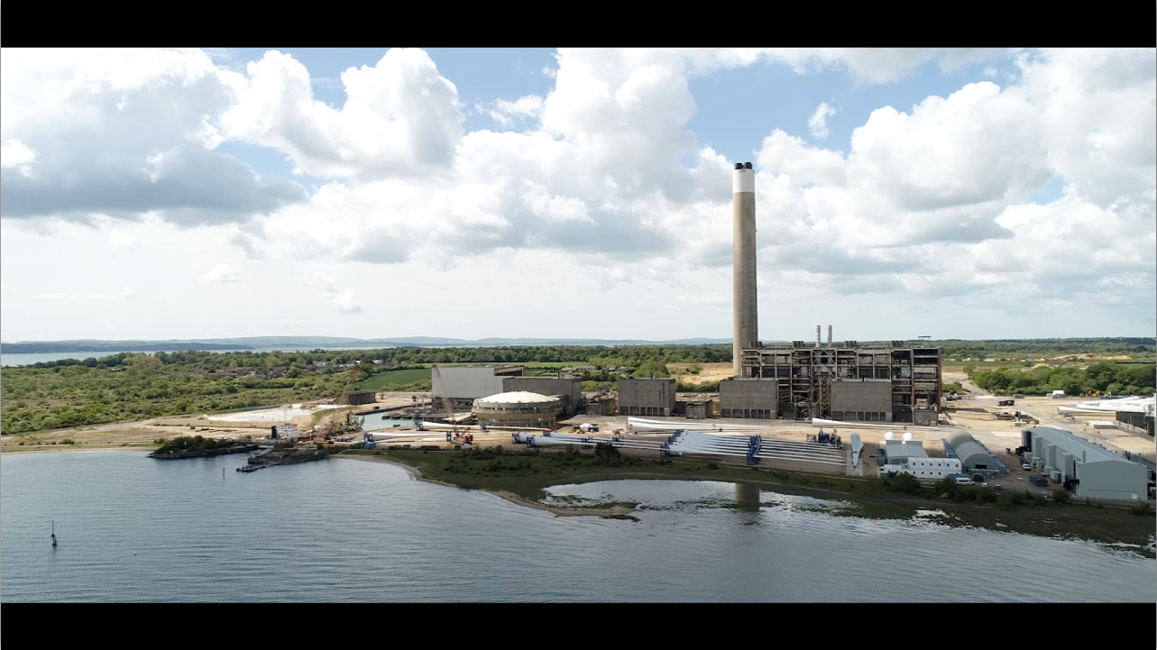

Slide 7
Sustainability, Vision & Framework
Fawley Waterside will take a ‘whole systems’ approach to sustainability, inspired by the One Planet Living framework.
Ambition
Rationale
Differentiators
Fawley’s core ambition is to showcase how we should live in the 21st Century; sustainability in all its forms (environmental, social & economic) must be central to this.
Our aim is to build a town that makes it easy & attractive to lead a sustainable life.
The built environment will encourage, rather than impede, eco-friendly behaviour, such as by designing out car use on-site, providing net-zero buildings, and connecting residents to the New Forest’s remarkable natural capital.
Fawley’s focus on sustainability reflects its location in a National Park, history as a power station & present as a home to the world’s largest wind turbine manufacturer.
The town will carry this thread into the future, transforming a 20th Century monument to fossil fuels into an exemplar of 21st Century green design.
Besides its enormous inherent value, sustainability can also benefit the project:
In the short term, it differentiates Fawley in the eyes of businesses & movers, strengthening prices & absorption rates.
In the mid-term, it helps demand remain buoyant as eco-friendly design & low energy bills become non-negotiable.
In the long-run, it minimises retrofitting costs & vulnerability to climate risk.
Fawley is not merely motivated to promote sustainability, it is unusually well placed to do so:
Its town scale allows it to adopt a ‘whole systems’ approach, bringing together aspects of sustainable living that aren’t possible at an individual building level, such as transport, food & jobs.
Its new build status is a chance to reimagine environmentally harmful design while unconstrained by legacy infrastructure.
Its desire to retain assets long term (e.g. PRS, some commercial) incentivises FWL to ensure buildings have low whole-life running costs & are future-proofed against tightening emissions regulations.
Its smart town technology can provide a powerful tool for minimising the town’s energy footprint, such as via a digital twin & smart micro grid.
Its target movers are also likely to self-select for eco-friendliness (given the location in a national park by the sea); these human factors can reduce the gap between a building’s predicted & actual performance.

Slide 8
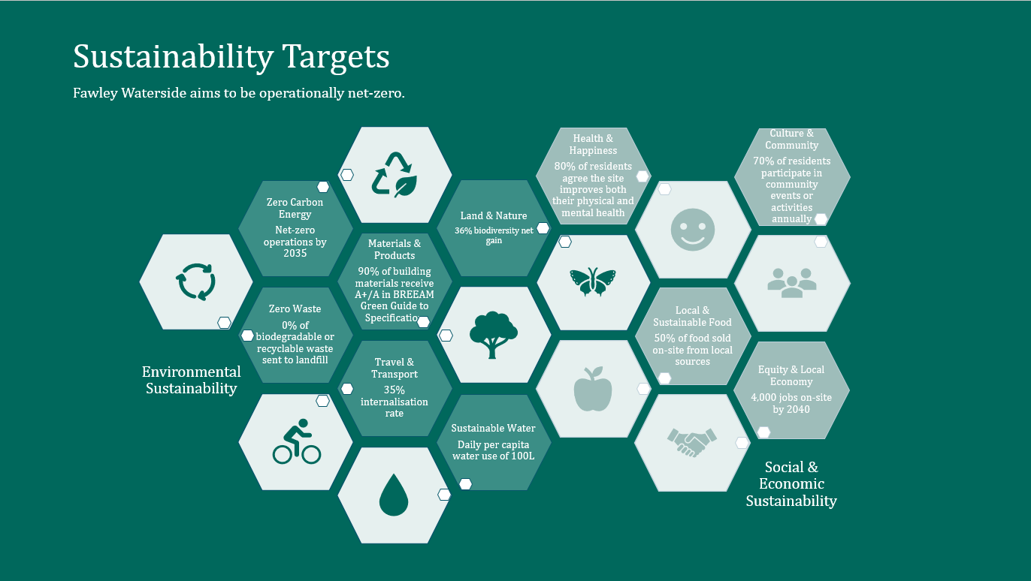

Slide 9
Example Sustainability Initiatives (1/2)
One Planet Living
Zero Carbon Energy
Materials & Products
Travel & Transport
Zero Waste
Land & Nature
Reduce energy demand via super-efficient design at building & town level
Regulated energy
Unregulated energy
Increase renewables’ share of energy supply
Smart (micro) grid
Smart generation from renewables (e.g. solar PV, air source heat pumps, waste heat)
Smart storage
Offset residual carbon emissions (as far as possible in on-site carbon sinks)
e.g. land restoration, urban forests
Demolish sustainably
98% Demolition Recovery
Design sustainably
BIM, build in layers, design for flexibility, modular buildings, de-materialisation
Source sustainably
Sustainable & local materials (CLT)
Build sustainably
Modern Methods of Construction
Operate sustainably
Product-as-a-Service contracting
Design for disassembly
Accelerate modal shift to zero-emissions active transport
Site designed for walkability & cycling
Accelerate modal shift to lower-emissions public transport
Bus
Ferry
Train (long-term aim)
On-site micro-transit
Accelerate modal shift to more sustainable car use
Car sharing
Support for EVs
Support for AVs
Reduce consumption
Design out regular car use & ownership
Asset sharing
Behavioural change via choice architecture
Prevent waste
Construction: DfMA
Buildings: design for adaptability/durability
Reuse materials (ExxonMobil waste heat)
Recycle (ENVAC pneumatic waste system)
Recover energy from waste
Promote biodiversity and create wildlife habitats, e.g.
Birds: saline lagoon
Animals: grazing land
Plants: urban forests
Marine life: vertipools
Restore and protect land
Large-scale integration
35+ ha. of recreational green spaces
Nature Park (long-term)
Enhance public access to nature
Internationally important natural capital

Slide 10
Example Sustainability Initiatives (2/2)
One Planet Living
Sustainable Water
Local & Sustainable Food
Health & Happiness
Equity & Local Economy
Culture & Community
Use water efficiently within the house
Water efficient appliances
Grey water recycling
Consumption tracking with smart meters
Sustainably manage water outside the home
Sustainable Drainage Systems (such as green roofs, rainwater harvesting, permeable paving)
Wastewater treatment
Promote local growing
On-site growing (dedicated spaces, community groups)
Procurement from sustainable local growers
Support sale of nutritious, sustainable, local food
Community co-op
Dedicated retail space
Flexible leases
Promote consumption of healthy food
Occupants
Visitors
Re-use food waste
Promote physical health
Design promoting physical health (walkability-focused masterplan, cycle-friendly design)
Access to healthy food
Healthcare facilities
Clean air
Ageing in place
Foster mental wellbeing
Ample leisure opportunities
Social infrastructure
Beautiful architecture
Connection to Nature
Create jobs as Freeport tax site
Target of 4,000 jobs focused on marine / smart technology
Develop local skills
Apprenticeship school
Training centre
Foster new businesses
Incubator
Access to talent via university partners
Improve access to affordable housing
35% affordable units
Enhance productivity
Fibre line enables ~20k new broadband connections
Design physical spaces that encourage social interaction
Public realm
Social infrastructure
Invest in community programming (volunteering, gardening groups, festivals)
Establish community governance mechanisms (community development trust)
Build relationships with the wider community
Transport links
Organisational links (with local schools, firms, charities)

Slide 11
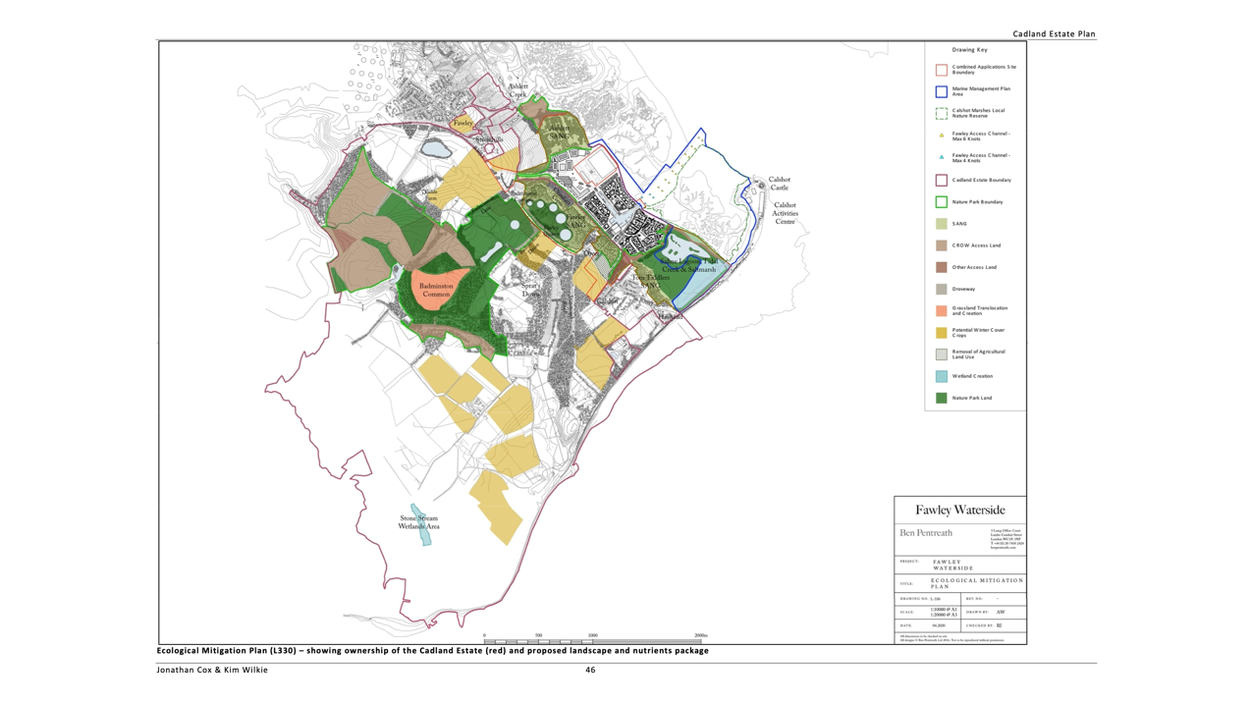

Slide 12
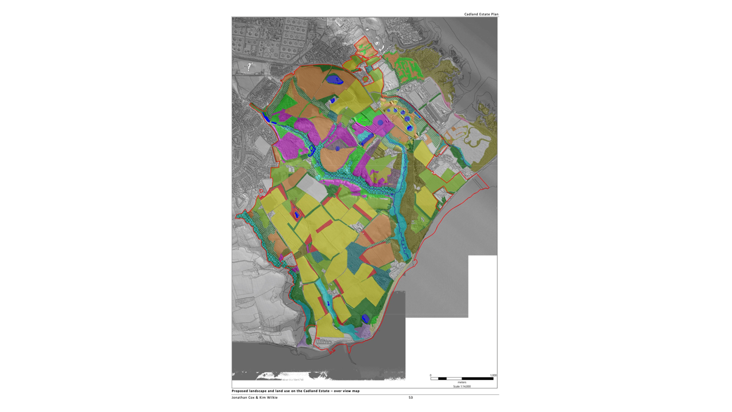

Slide 14
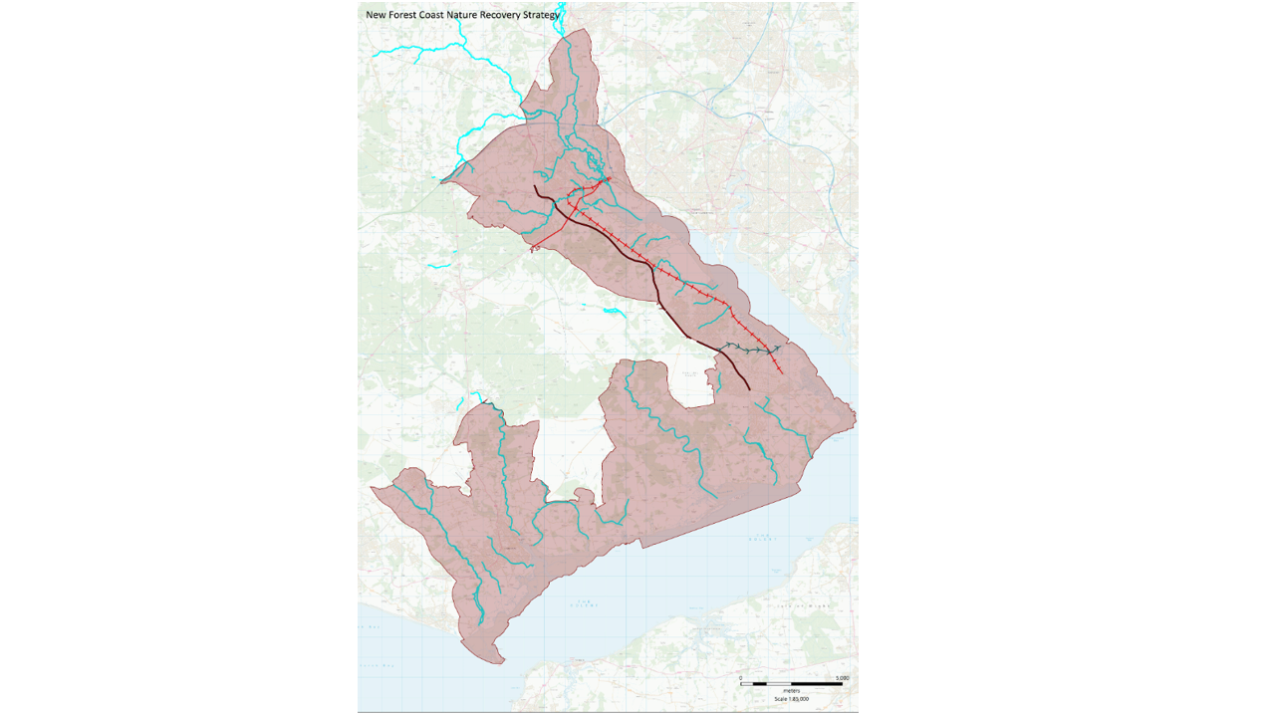

Slide 15
