Slide 1
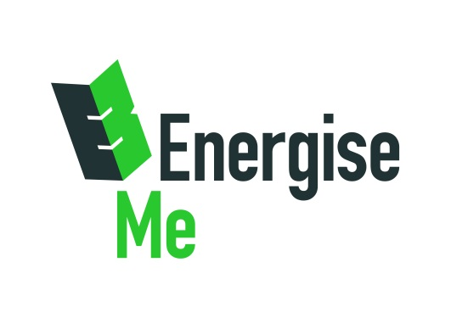
Natural Capital and Health An update
Green Halo Partnership One Year On
November 2018
Amanda Glenn West Hampshire CCG
Sophie Burton EnergiseMe
1

Slide 2
Natural Capital can be quite an abstract concept
However
Raised awareness of the value of outside space
Generated conversations about being outside
Strengthened partnerships
Kick-started some projects

Slide 3
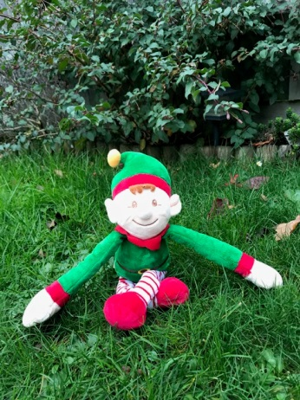
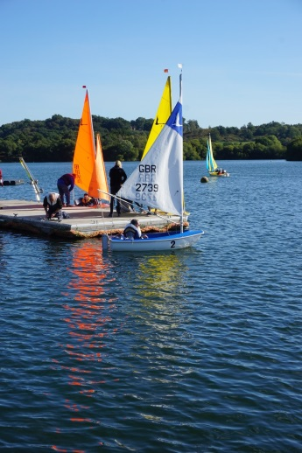
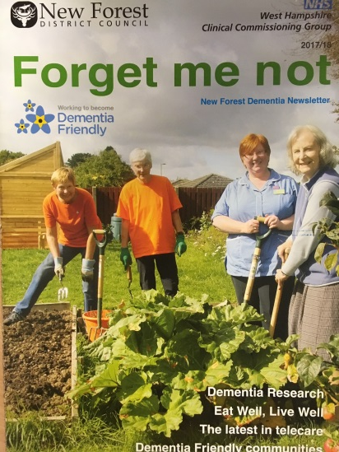
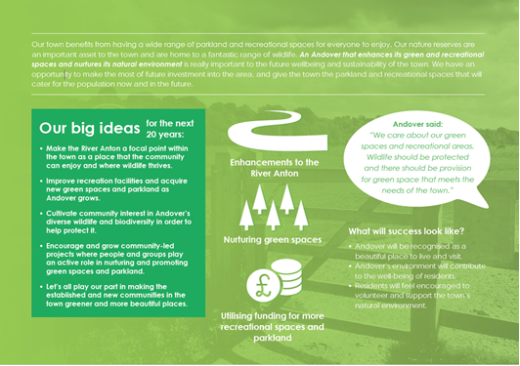
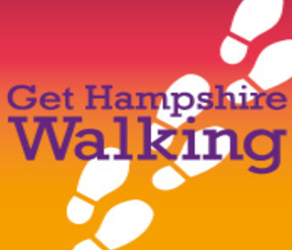
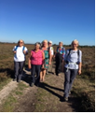
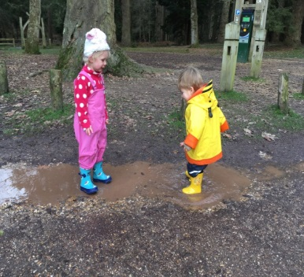
40 or 50 people come here in the summer, that’s for each session. It’s not just the getting out on boats, they can enjoy being outside and it’s sociable too.
It’s wonderful coming here. It’s a little bit of freedom, I can have a little wander while Sheila sits and watches the butterflies, she loves it.

Slide 4
There is increasing overlap with other drivers and opportunities
New Models of Care / Clusters
Sport England Getting Active Outdoors

