Slide 1
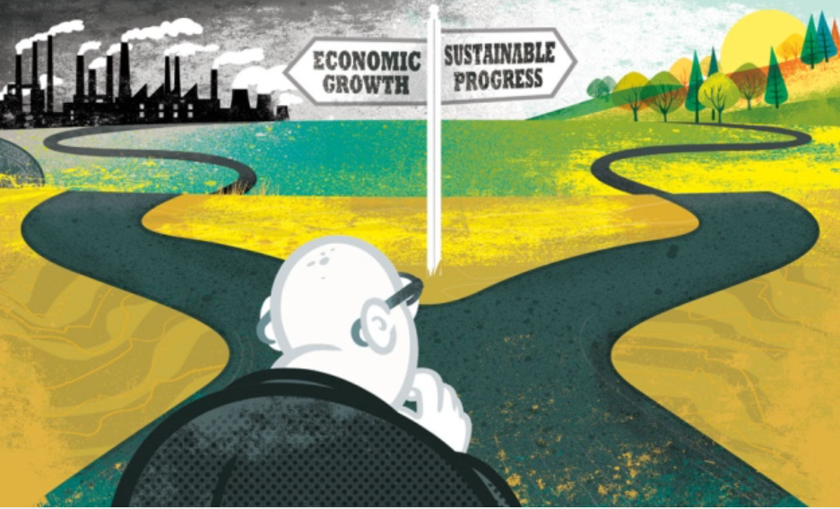
The Economy and Natural Capital

Slide 2
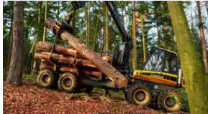
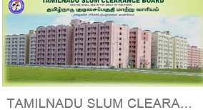
What has Natural Capital done for the Economy ?
Resources
Wealth
Raised some Living Standards

Slide 3
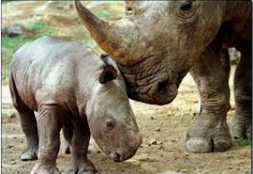
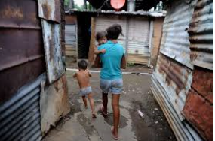
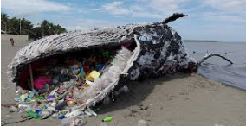
What has the Economy done for Natural Capital ?
Endangered Species
Habitats
Greed and Poverty
Pollution

Slide 4
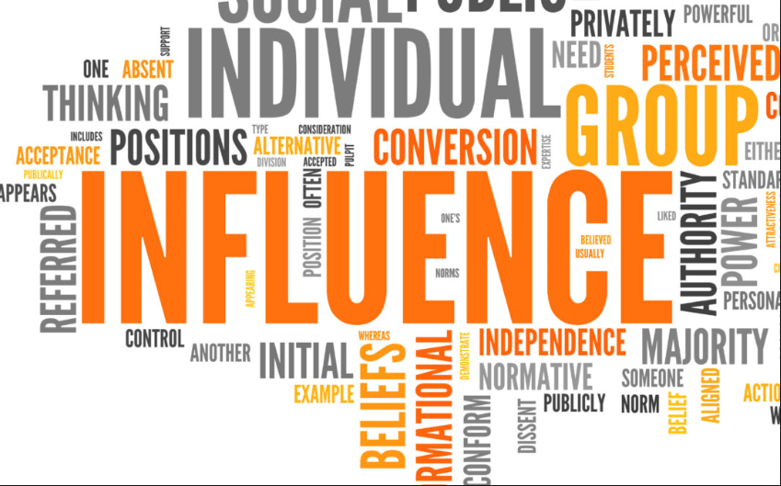
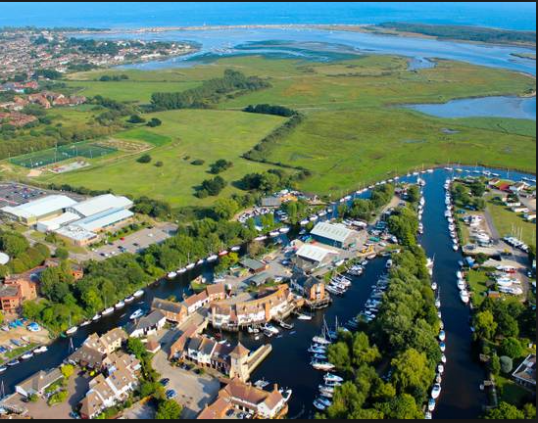
How can we reduce conflict / improve harmony ?
Speak out / lobby /
campaign :
Lead by example :

Slide 5
Inspired by Green Halo…………………………….

Slide 6
Benefits to the Economy and Natural Capital
Natural Capital | Economy
A new 17 Hectare Country Park Designation of the area as a SANG in perpetuity Reduced pressure on the Greenbelt for development Diversion of activity away from adjacent SSSI Increased biodiversity / creation of Wildlife corridors Environmental Education / Promotion of Healthy Lifestyles | Town Centre viability Increase in Council Tax income Increase in visitor spend Improved viability of Leisure Centre

Slide 7
Questions :
What are our asks from Government to help shift the balance in favour of Natural Capital ?
How do we make the idea of doing things which provide mutual gains between the Economy and nature more appealing ?

