Slide 1
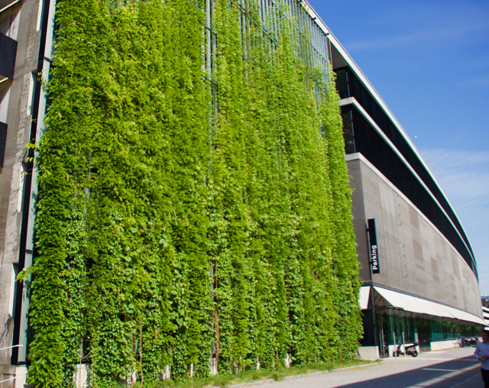
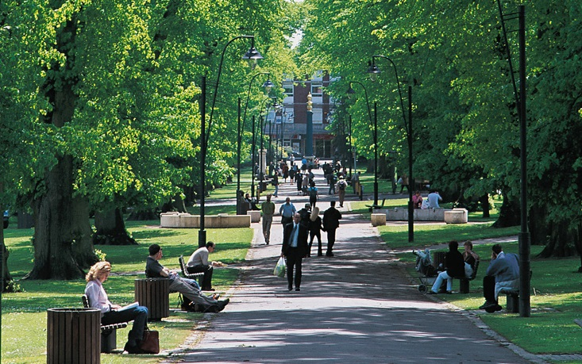
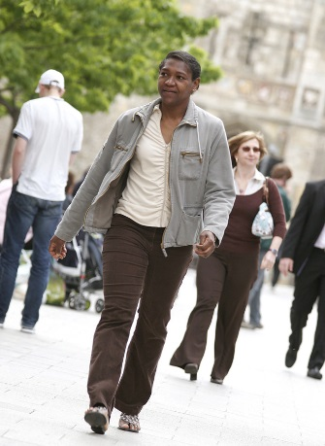
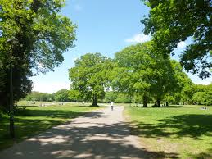
Workshop – Air Quality, how can natural capital help?
Cllr Steve Leggett, Cabinet Member for Green City, Southampton City Council
Notes:
background colour scheme, font - Arial, font size and font colour throughout. Please use upper and lower case as shown, not capitals.
Each slide uses a different layout, eg: there are three title pages:
• one with title, subtitle & images ( ‘click to add picture’ indicates a photographic image NOT clip art)
• one with title & subtitle - no images
• one with just title - no images
Look through the different slide layouts to see which templates will suit your presentation.
Select which slides to use and delete the others: Edit > Delete Slide.
If you need to use the same slide layout throughout the presentation go to the top drop down menu: >Insert > Duplicate Slide
The template is not foolproof - when using the the title page with images - you will need to resize pictures by following the directions in the notes below the slide layout - see slide two.
You will also need to align images/charts/etc where two or more are used on one slide
If any problems are encountered with the template,or you just need advice, please do not hesitate to contact Diane Wallace, Design Services, x2720

Slide 2
Air Quality and Health
Estimated 40,000 deaths attributed to poor air quality per year
110 deaths attributed to particulate pollution per year in Southampton
Costs to services, business, society and NHS £30bn per year
Evidence growing for impact on health including increased risk of lung disease, heart disease, cancer, diabetes, neurological disorders.
Most vulnerable in society most impacted by poor air quality
World Health Organisation guideline value for annual NO₂ of 40µg/m³
Road transport is recognized as the most significant contributor in UK cities.

Slide 3
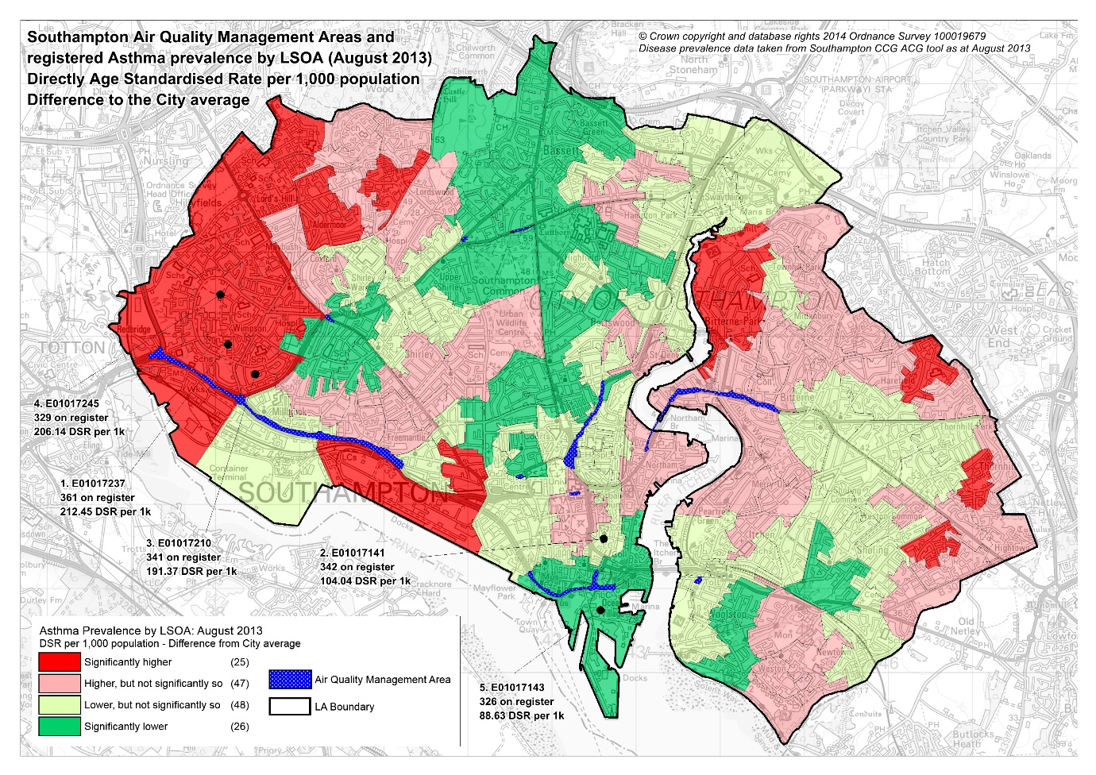

Slide 4

Mandated to Act
All local authority’s have a duty to assess local air quality and address exceedances.
The National Air Quality Plan for Nitrogen Dioxide in UK proposed to introduce Clean Air Zones (CAZ’s) in Southampton, Birmingham, Leeds, Nottingham and Derby.
SCC has implemented a Clean Air Strategy and has recently consulted on a proposed Clean Air Zone together with a programme of additional and supporting measures.
Notes:
Charging

Slide 5
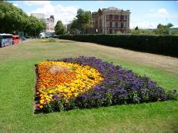
Key Facts
52 Parks
952 Hectares Green Space
240 Hectares Woodland
50,000 trees
8,700 individual grass plots
290,000m of shrubs maintained
53,600 linear metres of hedges
Parks & Open Spaces

